Slide 1
Kita Kasama App
MOBAPDE S20
Aquino, Kurt Neil
Choy, Matthew Seaver
Ramos, Luis Angelo
Notes:
Introductions: Hi I’m kurt, this is seaver, and this is luigi, blah blah

Slide 2
1
What scenarios led to the necessity of the app?
Notes:
Intro with: Who here has overprotective parents?

Slide 3
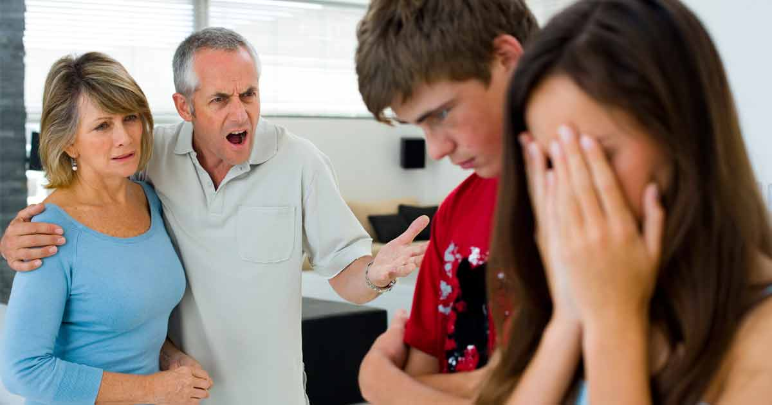
Notes:
Have you ever experienced your parents scolding you cuz you wanted to go outside and buy something from the convenience store late at night?

Slide 4
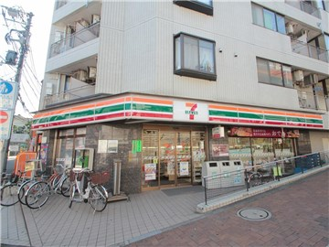

Slide 5
You live here
Notes:
Even though you live here

Slide 6
You live here
Notes:
And the convenience store is just right over there. So we are here to address that problem

Slide 7
2
What is the name of your app?
Notes:
So what is the name of our app?

Slide 8
Kita Kasama App
MOBAPDE S20
Aquino, Kurt Neil
Choy, Matthew Seaver
Ramos, Luis Angelo
Notes:
Our app is called Kita Kasama cuz even though we’re not beside the user, we want to let them know that we are with them in spirit and in heart

Slide 9
3
What functions does your app do that will solve #1?
Notes:
Q: So how do we make our parents worry less? A: By making them even more overprotective

Slide 10
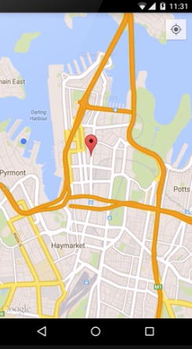
What does the app do?
Personal tracking app which uses geo-location
Notes:
So our app uses geo location in order to locate you geographically

Slide 11


I AM FINE
Buttons which sends update messages about your status
I AM FINE
I FEEL NERVOUS
CALL 117!!!
I FEEL NERVOUS
Notes:
The user will be able to send updates regarding their current status. Discuss positive, negative, and extreme statuses

Slide 12

I AM FINE
The user can also use gestures when their screen is off for status updates.
Notes:
Discuss gestures and how the app will keep running in the background

Slide 13
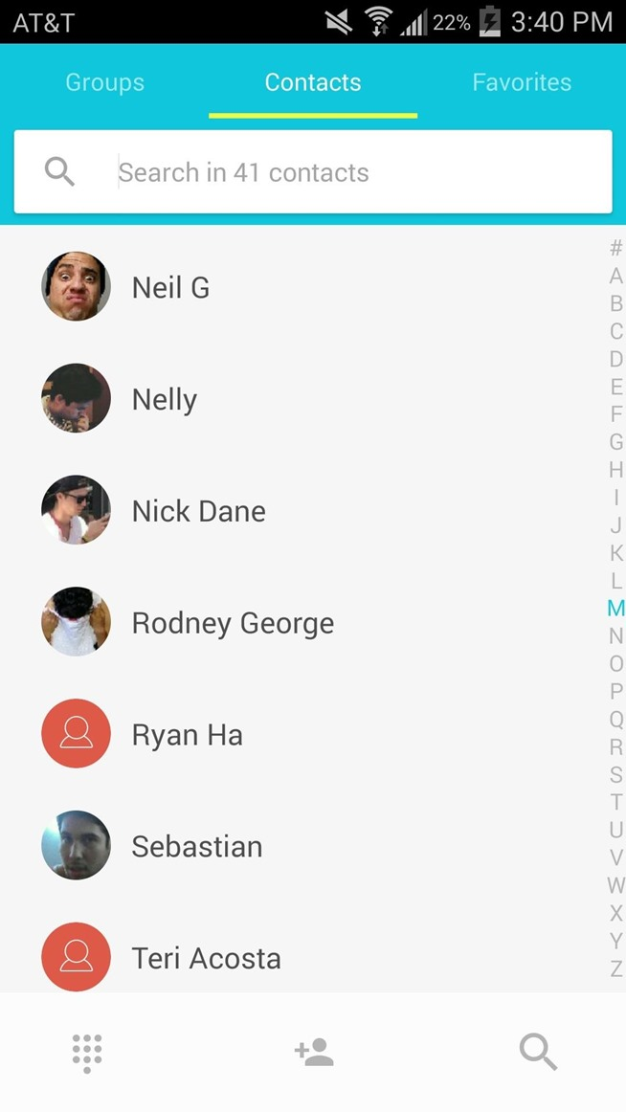
Tracking Code: 123456456
Select your desired monitors from your contacts to send your tracking code.
Notes:
Discuss how linking works: User-Monitor relationships

Slide 14
Monitors who received the message can then input the code in order to start the session.
Tracker Code
______________________
CANCEL
TRACK
Notes:
Discuss how linking works: User-Monitor relationships

Slide 15
Monitors will also be able to send confirmation messages to the user being tracked.
CONFIRM LAST MESSAGE
HOW ARE YOU?
Notes:
Discuss “I have read your last message”, and “How are you?” updates

Slide 16
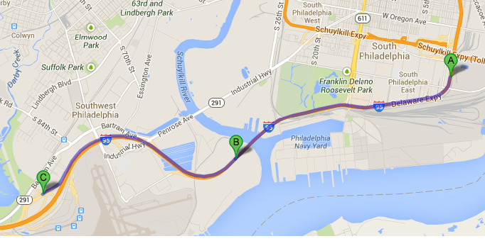
For those who does not have the app, a google route link will be sent instead.
Notes:
How people without the app track you: use google routes link

Slide 17
4
Who will benefit from your app?
Notes:
Who can benefit from our app

Slide 18
Notes:
Your parents won’t be as naggy anymore

Slide 19
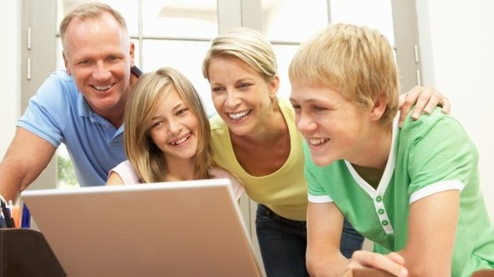
Notes:
So they’ll be less worried. Look at them happily using our app tracking their 5 year old

Slide 20
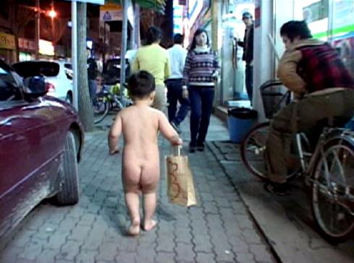
Notes:
There he is

Slide 21
I AM FINE
Notes:
And he is just fine…

Slide 22

Notes:
You will also benefit, cuz you know…you’re safe and shit

Slide 23
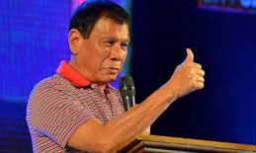
Notes:
Which is good

Slide 24
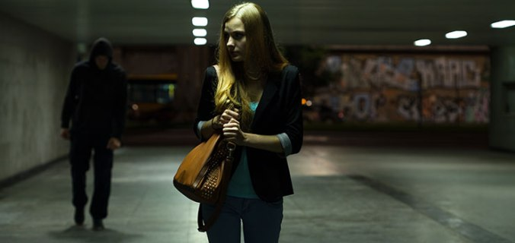
Notes:
And lastly your good old friendly neighborhood stalker

Slide 25
“Better to be safe than to be sorry”
- Some famous guy…
Notes:
Better be safe than be not safe at all

Slide 26
You live here
Notes:
Even though you really just live right over here

Slide 27
Thanks!
ANY QUESTIONS?

